Slide 1
Examining the Co-Evolution Relationship Between Simulink Models and their Test Cases
Eric J. Rapos and James R. Cordy

Slide 2
The Concept
As source models change over time, their corresponding tests need to stay up to date.
Our aim is to automate this process, but first we must understand the relationship between models and tests.

Slide 3
The Application
Models: Matlab Simulink
Domain: Automotive Industry (Partners)

Slide 4
The Goal
A change in a model from one version to the next can be identified, and its impact on test cases isolated – to be automatically implemented in the test case.

Slide 5
Example
In1 | In2 | Out1 | Out2
0 | 0 | 0
0 | 1 | 1
1 | 1 | 2
…
100 | 87 | 187
…
1000 | 2000 | 3000
1000 | 2001 | 3001
…

Slide 6
Example
In1 | In2 | Out1 | Out2
0 | 0 | 0
0 | 1 | 1
1 | 1 | 2
…
100 | 87 | 187
…
1000 | 2000 | 3000
1000 | 2001 | 3001
…

Slide 7
Example
In1 | In2 | Out1 | Out2
0 | 0 | 0 | 0
0 | 1 | 0 | 1
1 | 1 | 1 | 1
…
100 | 87 | 8700 | 87
…
1000 | 2000 | 2000000 | 2000
1000 | 2001 | 2001000 | 2001
…

Slide 8
But How?
Examine model and test versions to determine relationship between model changes and test changes.
But first: determine if a relationship exists at all between these artifacts – an industrial case study!

Slide 9
Research Questions
RQ1: Does test co-evolution happen synchronously or is there a delay?

Slide 10
Research Questions
RQ2: Is there a noticeable increase in development and test activity surrounding major releases or significant events? Is there a noticeable stabilization nearing the final release?

Slide 11
Research Questions
RQ3: Are there instances of changes to models that do not necessitate changes in the tests? If so, how common are they?

Slide 12
The Data Set
Models and tests provided by our industrial partners.
Matlab Simulink models, used for simulation, and eventual code generation for use in electronic control units (ECUs) in vehicles.

Slide 13
The Models
9 rings (collections of sub-components)
Model for each sub-component, plus one for the ring
Total of 55 sub-component models, and 9 ring integration models
15 releases over which models were updated (not all models exist in each release)

Slide 14
Models Provided
 | Rings
Rel. | 1 | 2 | 3 | 4 | 5 | 6 | 7 | 8 | 9
1 | 4 | 4 | 8 | 11 | 4 | 4 | 10 | 7 | 8
2 |  |  |  | 11 |  |  | 10
3 | 4 | 4 | 8 | 10 | 4 | 4 | 10 | 7 | 8
4
5
6 | 5 | 5 | 8 | 10 |  |  | 10 | 7 | 8
7 | 5 | 4 |  | 10 |  |  |  | 7
8 | 6 | 4 | 8 | 10 | 3 | 3 | 10 | 7 | 8
9
10 |  | 4 | 4 |  |  |  | 10 | 7 | 8
11 | 6 | 4 | 8 | 10 | 3 | 3 | 10 | 7 | 8
12
13 | 6 |  |  |  | 3 | 3 | 10
14
15 | 6 | 4 | 8 | 10 | 3 | 3 | 10 | 7 | 8

Slide 15
Preprocessing
As you will note, there were many blanks – we needed to remove blank rows, and fill in any other holes by creating duplicates of previous releases.
After all of this, we ended up with 53 component models over 9 releases, for a total of 477 models and corresponding tests.

Slide 16
Process
Model Comparison
Test Comparison
Co-Evolution Relationship

Slide 17
Model Comparison
Pairwise differencing between two consecutive versions of the same model (results in 8 comparisons)
Possible Results:
No Change
Model Does Not Exist Anymore (but existed previously)
Model Does Not Exist Yet (but will exist in a later release)
Model Newly Created This Release
Model Deleted This Release
Model Was Modified
listed as # of additions, modifications, and deletions

Slide 18
Model Comparison
Custom Matlab Script to examine differences using XML comparison (part of built-in Matlab tool)
Remove any non-semantic changes, and other irrelevant information.

Slide 19
Test Comparison
Similar pairwise comparison of consecutive versions of Excel Spreadsheet files (test format).
Possible Results:
No Change
Test Does Not Exist Anymore (but existed previously)
Test Does Not Exist Yet (but will exist in a later release)
Test Newly Created This Release
Test Deleted This Release
Test Was Modified
listed as # of test cases added or removed OR # of tests which are the same and # of tests that have changed

Slide 20
Test Comparison
Using Matlab, read in Excel spreadsheets corresponding to tests, and perform cell-to-cell comparison

Slide 21
Co-Evolution Relationship
For a given model comparison and test comparison, determine the co-evolution relationship between the artifacts.
Possible Results:
(1) No Change In Both
(2) Model and Test Do Not Exist in Both Releases
(3) Model and Test Newly Added This Release
(4) Model and Test Deleted This Release
(5) Change in Model But Not In Test
(6) No Change in Model But Change In Test
(7) Change in Model and Test

Slide 22
Co-Evolution Relationship
For a given model comparison and test comparison, determine the co-evolution relationship between the artifacts.
Possible Results:
(1) No Change In Both
(2) Model and Test Do Not Exist in Both Releases
(3) Model and Test Newly Added This Release
(4) Model and Test Deleted This Release
(5) Change in Model But Not In Test
(6) No Change in Model But Change In Test
(7) Change in Model and Test

Slide 23
So What Did We Find?
The final result was a table with a row for each model, and a column for each version comparison (i.e. release 13 – release 15).
In each cell is the numerical value corresponding the results on the previous slide (1-7).

Slide 24
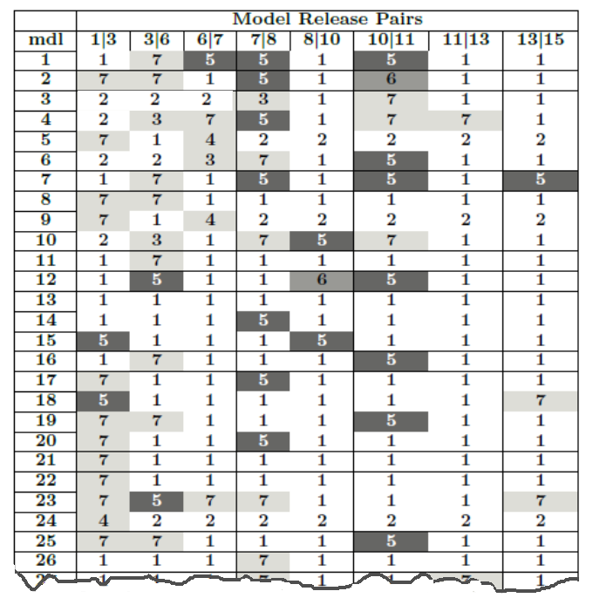
White - No Change in Both (1,2)
Light Gray - Co-Evolution Occurrence (3,4,7)
Medium Gray - Change in Test, None in Model (6)
Dark Gray - Change in Model, None in Test (5)
…

Slide 25
Analysis

Slide 26
RQ1:
Does co-evolution happen synchronously or is there a delay?

Slide 27
Evolution Disparity

Slide 28
Discussion
We found that approximately 90% of cases resulted in the tests co-evolving alongside the models.
Of the ~10%, most are instances where there are changes in models but not tests (result 5) which will be discussed in RQ3.
There were 8 occurrences of the tests changing and the model not (result 6) which required further analysis.

Slide 29
Discussion
We were able to conclude that for this model set, and that when a change to test suites is required, it is completed prior to the end of the current release cycle and no delay is found.

Slide 30
RQ2:
Is there a noticeable increase in development and test
activity surrounding major releases or significant events? Is
there a noticeable stabilization nearing the final release?

Slide 31
Discussion
The answer to this question can be found by examining the percentage of models and/or test that change surrounding these events, as compared to the releases immediately prior.
Based on domain knowledge, we know that releases 1, 3, 8, 11, and 15 are the major releases for this software.

Slide 32
Models & Tests Changed at Each Release

Slide 33
Types of Change Over Time

Slide 34
Discussion
Based on this analysis, it can be concluded that there are certainly indications of increased testing efforts around major releases and stabilization approaching the final release.

Slide 35
RQ3:
Are there instances of changes to models that do not
necessitate changes in the tests? If so, how common are
they?

Slide 36
Discussion
While it is evident that there are indeed instances of this phenomenon, the question of frequency is more interesting.
There were 50 occurrences of a change in a model and not test in our data set, compared to a total of 110 model changes occurring. This equates to 45.5% of model changes not requiring a change in the test suite.

Slide 37
Conclusions and Future Work

Slide 38
Conclusions
We were able to conclude that there is a strong positive correlation between models changed and tests changed
r(6) = 0.9; p < 0.01
We also were able to provide evidence for increased changes surrounding major releases and stabilization approaching the final release.

Slide 39
Future Work
Make use of results to determine how to implement automation of test updates using based solely on differences in models (result of 7).
Results of 5 (model updates not requiring test changes) will be equally as valuable in this implementation.

Slide 40
Thank You
eric@cs.queensu.ca
www.ericrapos.ca
@EricRapos

